Slide 1
Coal Production and Dispatch Analysis
An overview of coal production trends and dispatch performance

Slide 2
Dataset Overview
The dataset includes:
- Coal production and dispatch data
- Monthly performance
- Targets vs. actual values
- Cumulative production

Slide 3
Key Companies in the Dataset
ECL
BCCL
CCL
NCL
WCL
SECL

Slide 4
Monthly Production Trends
Analyzing the production trends over the months shows seasonal variations and target adherence.

Slide 5
Target vs. Actual Production
Comparison between target production and actual output to measure efficiency and performance.

Slide 6
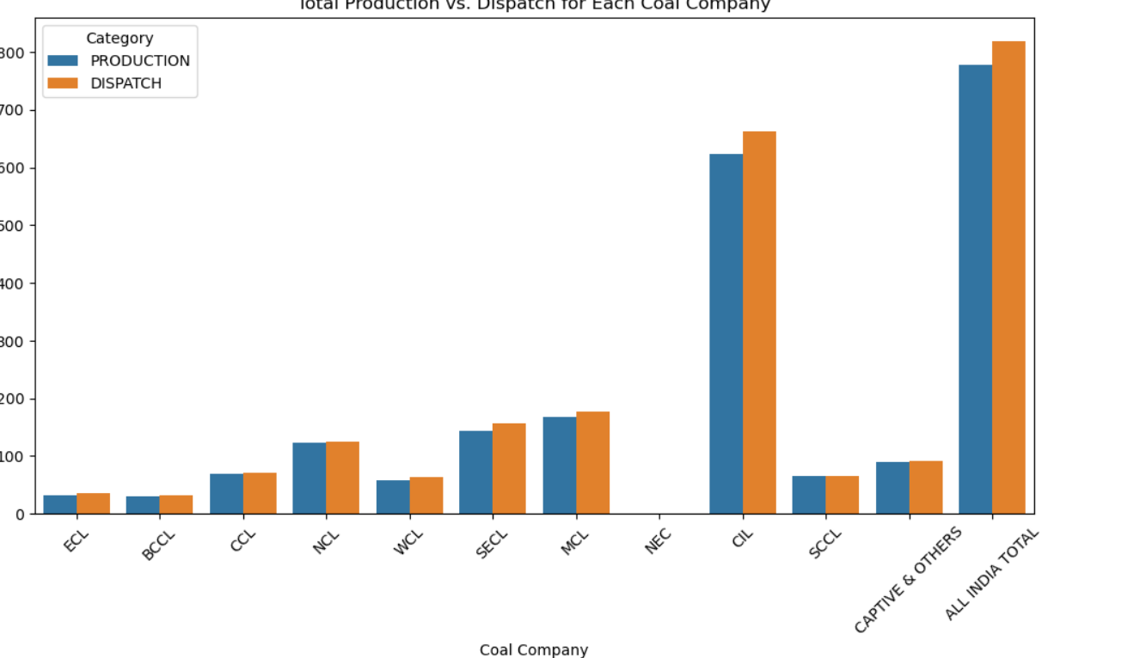
Screenshot 1

Slide 7
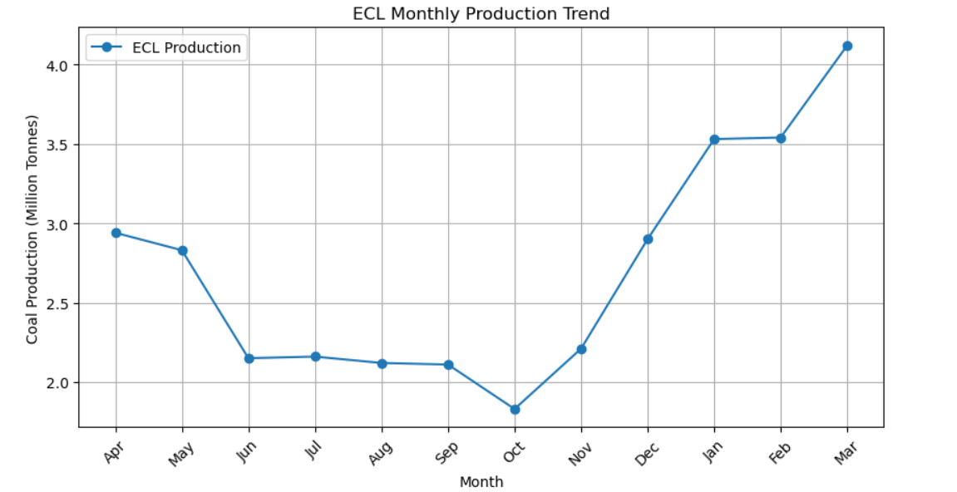
Screenshot 2

Slide 8
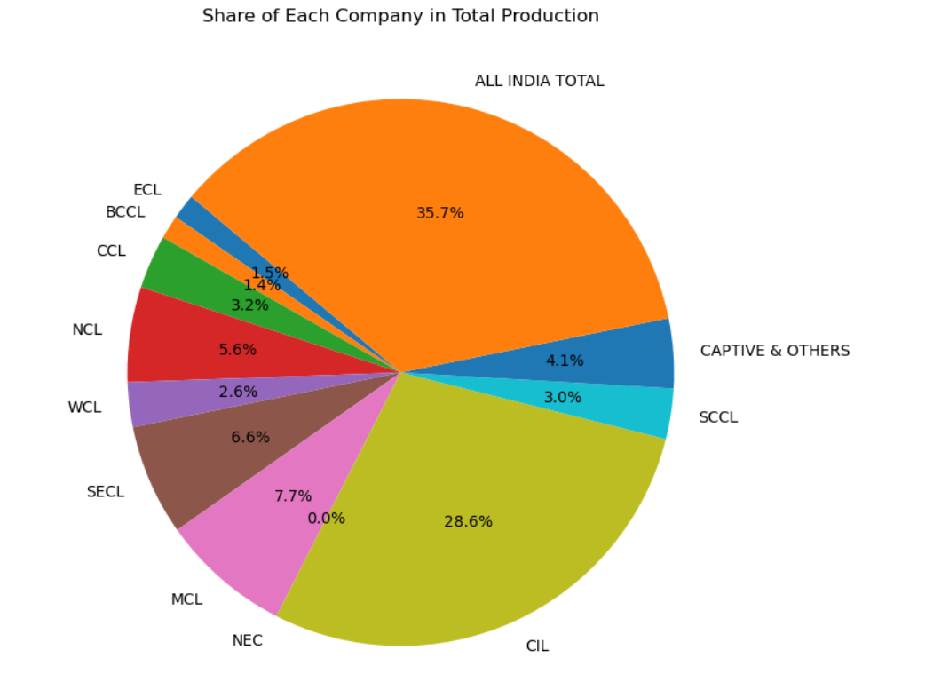
Screenshot 3

Slide 9
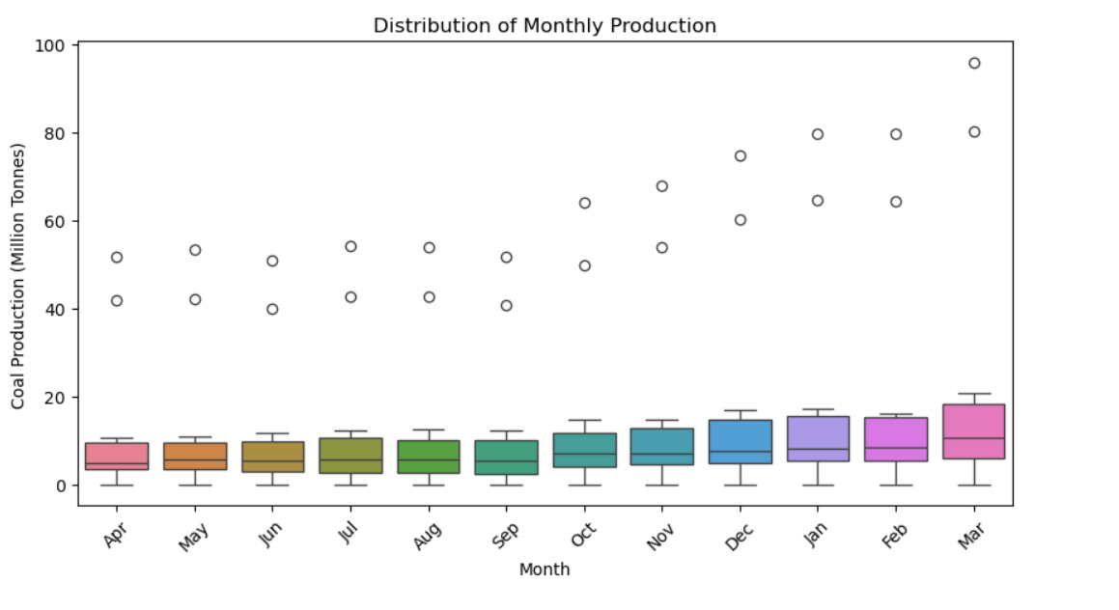
Screenshot 4

Slide 10
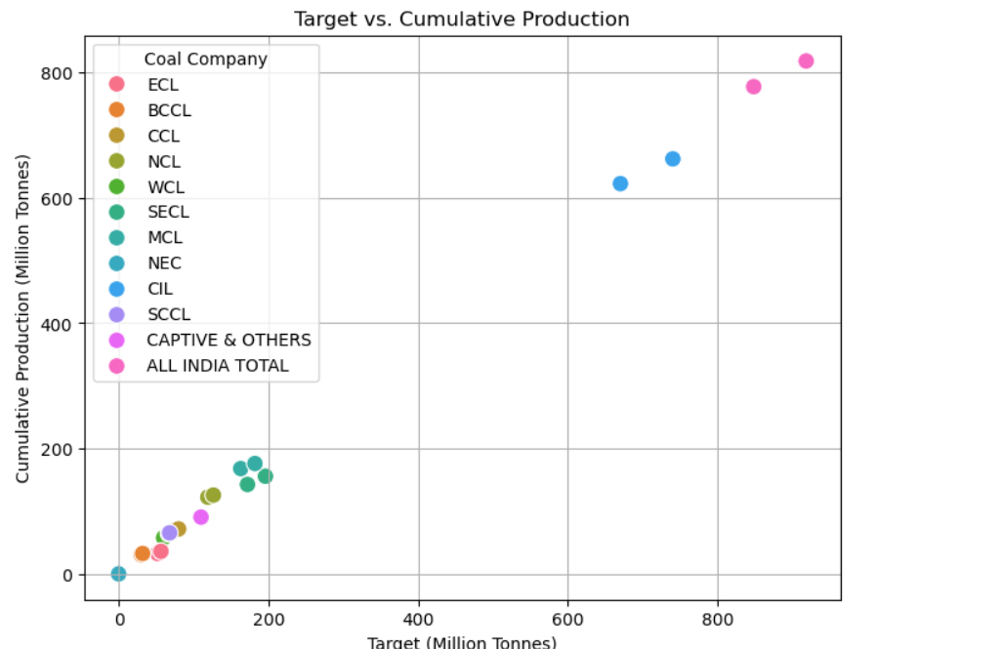
Screenshot 5

